Slide 1
STA/BST 222 Survival Analysis Lecture 13
Lihong Qi
Division of Biostatistics
Department of Public Health Sciences
School of Medicine
Nov 12, 2020

Slide 2
How to contact me
Email is best: lhqi@ucdavis.edu
Phone: 530-754-9234
Office hour: email for an appointment

Slide 3
How to contact TA
Xiner Zhou
Email: xezhou@ucdavis.edu
Office hours: 7:00pm – 8:00pm, Thursdays
Lab: 6:10-7:00 pm, Thursdays
For both Lab and OH, please use the zoom link with passcode: survival https://ucdstats.zoom.us/j/9681353237?pwd=ZzhLRHlhNG92bHFUaHkwM0Fib1pqQT09 Meeting ID: 968 135 3237

Slide 4
Focus
Semiparametric proportional hazards (PH) regression
Ties
Local test

Slide 5
“Full” likelihood function
Need to specify the likelihood function to perform estimation for the parameters, .
Review: likelihood function for survival data can be expressed using hazard function
Hazard function under a Cox model

Slide 6
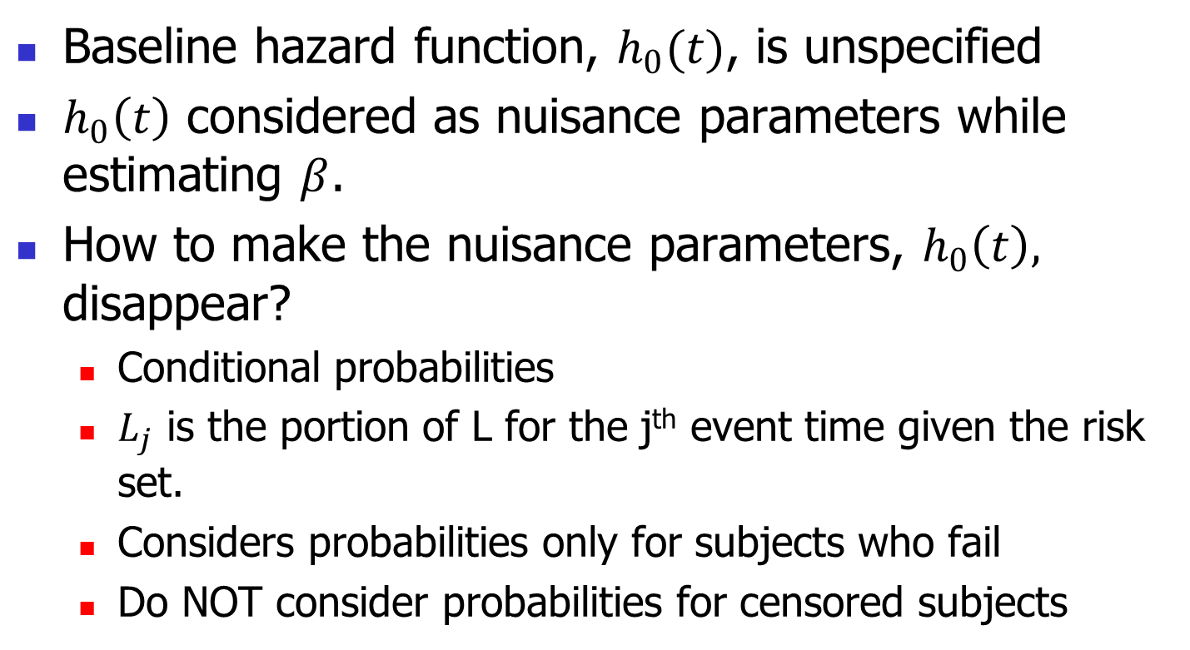
Issues with the “full” likelihood function
Baseline hazard function, $h_{0}(t)$, is unspecified
$h_{0}\left(t\right)$ considered as nuisance parameters while estimating $β$.
How to make the nuisance parameters, $h_{0}\left(t\right),$ disappear?
Conditional probabilities
$L_{j}$ is the portion of L for the j^{th} event time given the risk set.
Considers probabilities only for subjects who fail
Do NOT consider probabilities for censored subjects

Slide 7
Partial Likelihood

Slide 8
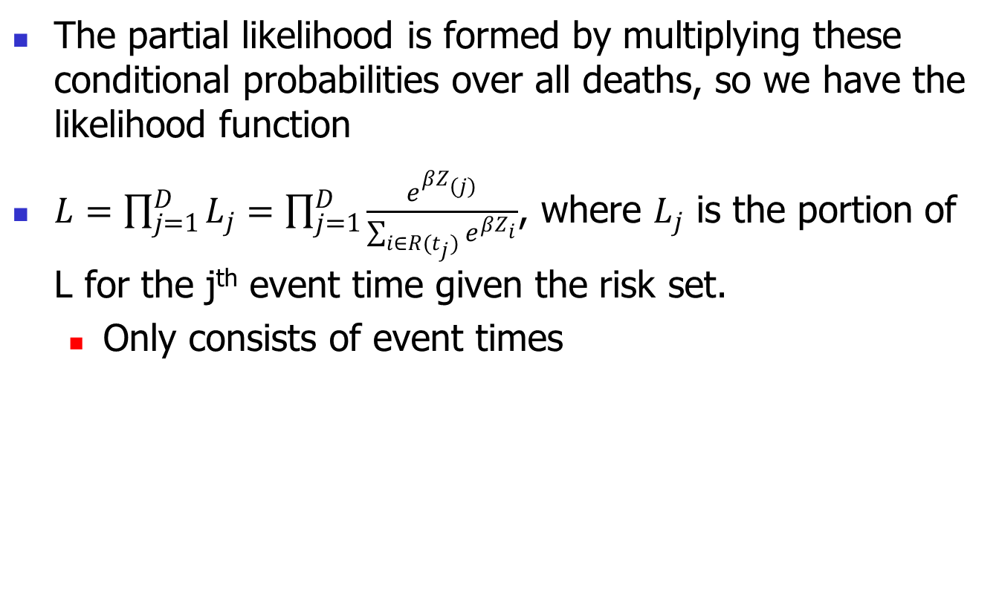
Partial Likelihood
The partial likelihood is formed by multiplying these conditional probabilities over all deaths, so we have the likelihood function
$L=\prod_{j=1}^{D}{L_{j}=\prod_{j=1}^{D}{\frac{e^{βZ_{(j)}}}{\sum_{i∈R(t_{j})}{e^{βZ_{i}}}}}}$, where $L_{j}$ is the portion of L for the j^{th} event time given the risk set.
Only consists of event times

Slide 9
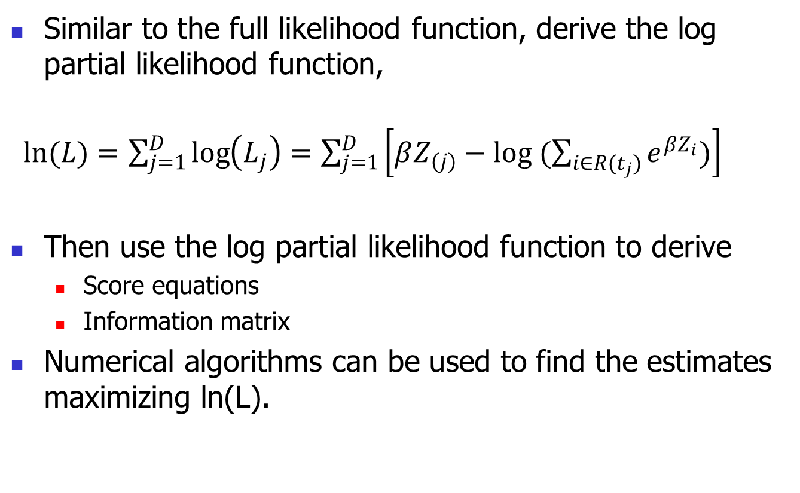
Estimation using partial likelihood
Similar to the full likelihood function, derive the log partial likelihood function, $⁡$
$ln(L)=\sum_{j=1}^{D}{\log\left(L_{j}\right)=\sum_{j=1}^{D}{\left[βZ_{(j)}−log (\sum_{i∈R(t_{j})}{e^{βZ_{i}}})\right]}}$
Then use the log partial likelihood function to derive
Score equations
Information matrix
Numerical algorithms can be used to find the estimates maximizing ln(L).

Slide 10
Computing Hazard Ratio
Hazard ratio( )
HR estimate
95% CI for
95% CI for

Slide 11
Partial likelihood when ties are present

Slide 12
How to handle ties?
Tied death times will create problems while deriving partial likelihood, but tied censored times or tied censored and death times will NOT.
Four approaches for handling ties
Breslow (1974): simplest but overestimate denominator
Efron (1977): simple and best approximation
Discrete: assume a logistic model for hazard rate
Exact: consider all possible combinations
When the number of ties is small, Efron’s and Breslow’s likelihoods are quite close.
SAS PHREG uses Breslow’s likelihood as a default and allows the user to specify other methods.

Slide 13
Notation

Slide 14
Breslow’s method (1974)

Slide 15
Breslow method (1977)

Slide 16
An Example
Assume 3 deaths at time 0.5. All 3 deaths have Z=1 and 10 subjects at risk with Z=1 and 15 subjects at risk with Z=0
Breslow

Slide 17
Local test

Slide 18
Local Tests

Slide 19
Wald test

Slide 20
Likelihood ratio test

Slide 21
Score test

Slide 22
Local Tests
Only want to test a subset of regression coefficients.
For example (β1-β4): H0: β1=β2=β3=0
LR test requires to fit two models
What are the two models?
Wald tests require to obtain the information matrix of the full model
Score test does not require the information matrix of the full model.

Slide 23
Example: Larynx Cancer study, KM 1.8
A study of 90 patients diagnosed with cancer of the larynx in the 70s at a Dutch hospital
The data consists of the times between first treatment and either death or the end of the study
Patients were classified by the stage of their disease using the American Joint Committee for Cancer Staging
Test the hypothesis
H0: there is no difference in the death rates among the four stages of the disease
Ha: the higher stage, the higher the death rate

Slide 24
Example: Larynx Cancer data, KM 1.8
Laryngeal Cancer Data
90 males diagnosed with laryngeal cancer
Variables at diagnosis
Cancer stage
Age
Year
Objective: estimate survival after diagnosis and determine whether it is associated with cancer stage or age.

Slide 25
Data summary (n=90 males)
Variable | mean±SD/Frequency (%)
Stage
I | 33 (36.67%)
II | 17 (18.89%)
III | 27 (30.00%)
IV | 13 (14.44%)
Age | 64.61±10.80
Year of diagnosis
1970~1972 | 23 (25.56%)
1973~1975 | 33 (36.67%)
1976~1978 | 34 (36.77%)
Death | 50 (55.56%)
Median follow-up (year) | 6.50 (5.10, 7.50)

Slide 26
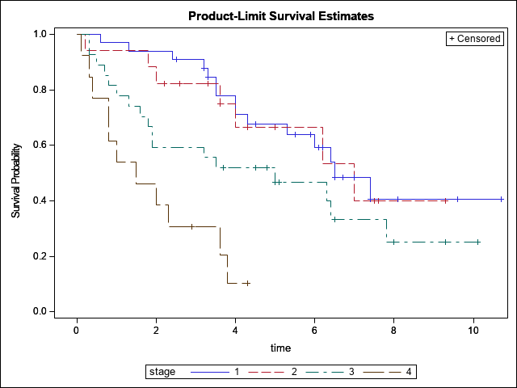
KM survival curves by cancer stage

Slide 27
Summary of survival time by stage
Stage | N | # of death | Median survival time
I | 33 | 15 (45.45%) | 6.50 (4.30, NA)
II | 17 | 7 (31.18%) | 7.00 (3.60, NA)
III | 27 | 17 (62.96%) | 5.00 (1.60, 7.80)
IV | 13 | 11 (84.62%) | 1.50 (0.40, 3.60)
Log-rank test: p<0.0001.

Slide 28
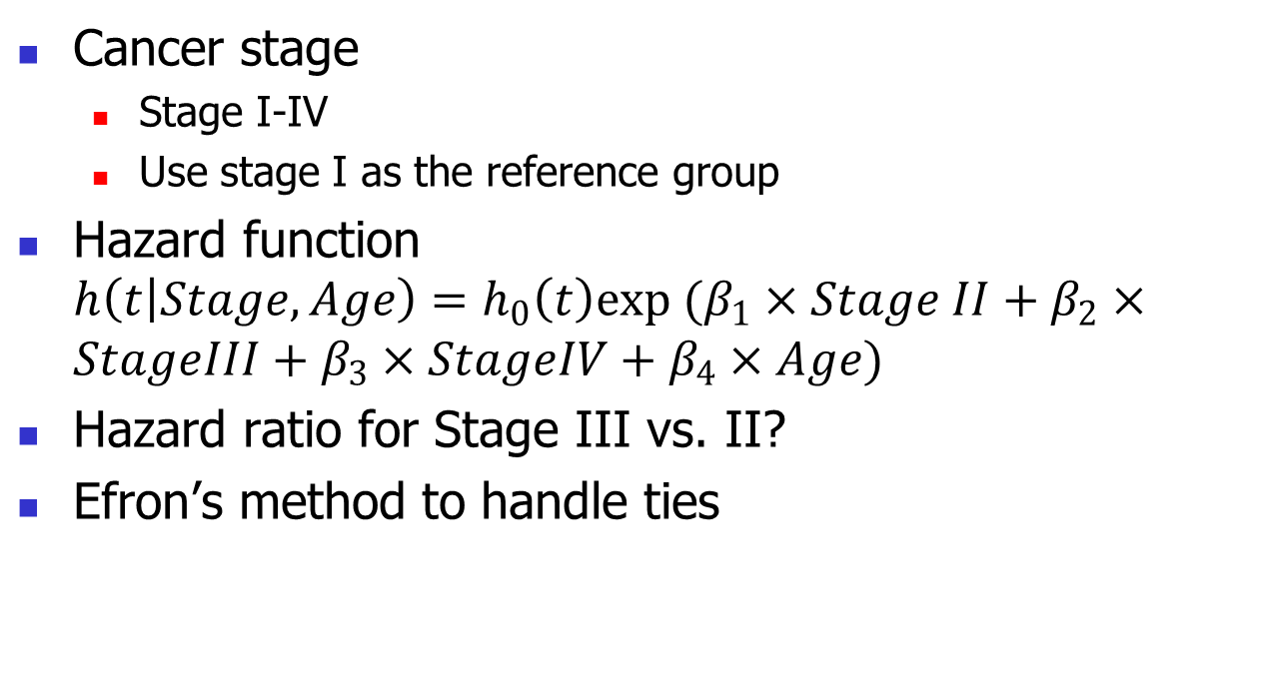
Cox PH model specification
Cancer stage
Stage I-IV
Use stage I as the reference group
Hazard function $h\left(t | Stage, Age\right)=h_{0}\left(t\right)exp (β_{1}×Stage II+β_{2}×StageIII+β_{3}×StageIV+β_{4}×Age)$
Hazard ratio for Stage III vs. II?
Efron’s method to handle ties

Slide 29
Global Test
Likelihood ratio test
Score test
Wald test
Likelihood ratio test is preferred
Conclusion?
Testing Global Null Hypothesis: BETA=0
Test Chi-Square DF Pr > ChiSq
Likelihood Ratio 18.3122 4 0.0011
Score 24.7789 4 <.0001
Wald 21.1571 4 0.0003

Slide 30
Regression coefficient estimates and HR
HR for Stage II vs. I:
HR for Stage III vs. I:
HR for Stage IV vs. I:
HR for age:
Conclusion:
Analysis of Maximum Likelihood Estimates
Parameter Standard Hazard 95% Hazard Ratio
Parameter DF Estimate Error Chi-Square Pr > ChiSq Ratio Confidence Limits
stage2 1 0.13989 0.46250 0.0915 0.7623 1.150 0.465 2.847
stage3 1 0.64218 0.35612 3.2517 0.0713 1.901 0.946 3.820
stage4 1 1.70623 0.42189 16.3563 <.0001 5.508 2.409 12.593
age 1 0.01903 0.01426 1.7812 0.1820 1.019 0.991 1.048

Slide 31
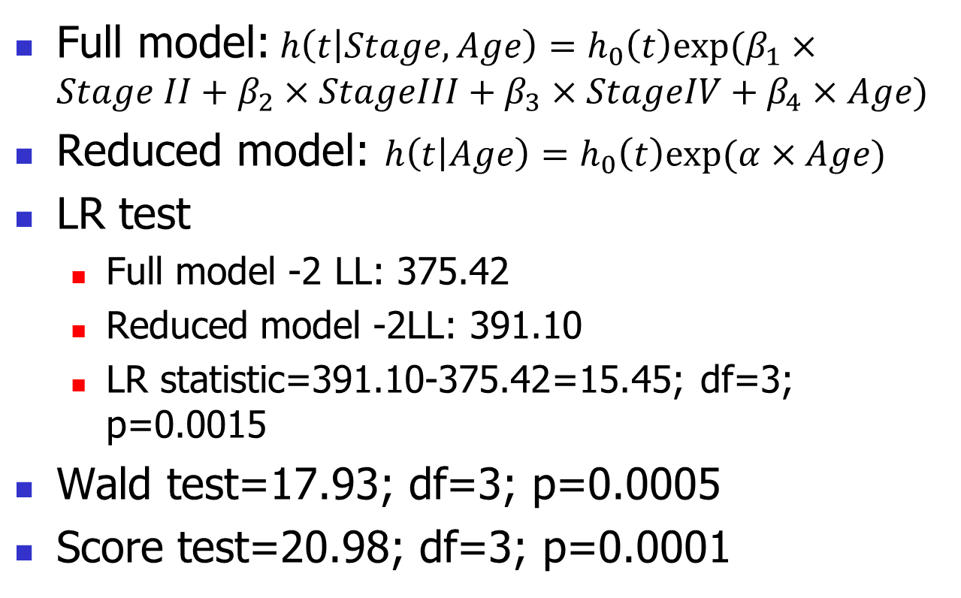
Local test for stage
Full model:$h\left(t | Stage, Age\right)=h_{0}\left(t\right)exp⁡(β_{1}×Stage II+β_{2}×StageIII+β_{3}×StageIV+β_{4}×Age)$
Reduced model: $h\left(t | Age\right)=h_{0}\left(t\right)exp⁡(α×Age)$
LR test
Full model -2 LL: 375.42
Reduced model -2LL: 391.10
LR statistic=391.10-375.42=15.45; df=3; p=0.0015
Wald test=17.93; df=3; p=0.0005
Score test=20.98; df=3; p=0.0001

Slide 32
Efron vs. Breslow (Global test)
Efron: Testing Global Null Hypothesis: BETA=0
Test Chi-Square DF Pr > ChiSq
Likelihood Ratio 18.3122 4 0.0011
Score 24.7789 4 <.0001
Wald 21.1571 4 0.0003
Breslow: Testing Global Null Hypothesis: BETA=0
Test Chi-Square DF Pr > ChiSq
Likelihood Ratio 18.0670 4 0.0012
Score 24.3274 4 <.0001
Wald 20.8256 4 0.0003

Slide 33
Efron vs. Breslow (Estimation)
Analysis of Maximum Likelihood Estimates (Efron)
Parameter Standard Hazard 95% Hazard Ratio
Parameter DF Estimate Error Chi-Square Pr > ChiSq Ratio Confidence Limits
stage2 1 0.13989 0.46250 0.0915 0.7623 1.150 0.465 2.847
stage3 1 0.64218 0.35612 3.2517 0.0713 1.901 0.946 3.820
stage4 1 1.70623 0.42189 16.3563 <.0001 5.508 2.409 12.593
age 1 0.01903 0.01426 1.7812 0.1820 1.019 0.991 1.048
Analysis of Maximum Likelihood Estimates (Breslow)
Parameter Standard Hazard 95% Hazard Ratio
Parameter DF Estimate Error Chi-Square Pr > ChiSq Ratio Confidence Limits
stage2 1 0.13842 0.46232 0.0896 0.7646 1.148 0.464 2.842
stage3 1 0.63815 0.35609 3.2116 0.0731 1.893 0.942 3.804
stage4 1 1.69333 0.42218 16.0876 <.0001 5.438 2.377 12.438
age 1 0.01890 0.01425 1.7589 0.1848 1.019 0.991 1.048

Slide 34
Some Notes
LR and Wald tests have similar convergence rate; score test is slower.
Based on a simulation study of small sample size for a binary covariate:
the likelihood ratio test and Wald test performed similarly (although the likelihood test ratio test slightly outperformed the Wald test for smaller sample sizes).
the score test was markedly inferior and is not recommended because it tends to inflate the size of the test.

Slide 35
Homework
Reading: KM 8.1-8.5
Other: to be posted

